Slide 1



Wissenswertes
PENDURA
Detecting illegal deforestation via satellite imagery
and connecting remote environments to accountability databases.

Slide 2
Idee
Structure
Background
Port form database
API pull
Map processing
Danger Scoring
Future improvement
EU Law – EUDR (European Deforestation Regulation)
Accountability for Supply chains
Importer/Manufacturer/Seller
Deforestation in supply chain Illegal
Solution
Questionary for everybody
But are the statements true?

Slide 3
Idee
Structure
Background
Port form database
API pull
Map processing
Danger Scoring
Future improvement
Check the given Geolocation data
Calculate score for probability of illegal Forest clearing
Reassure sellers they aren’t committing a crime (And automate everything)

Slide 4
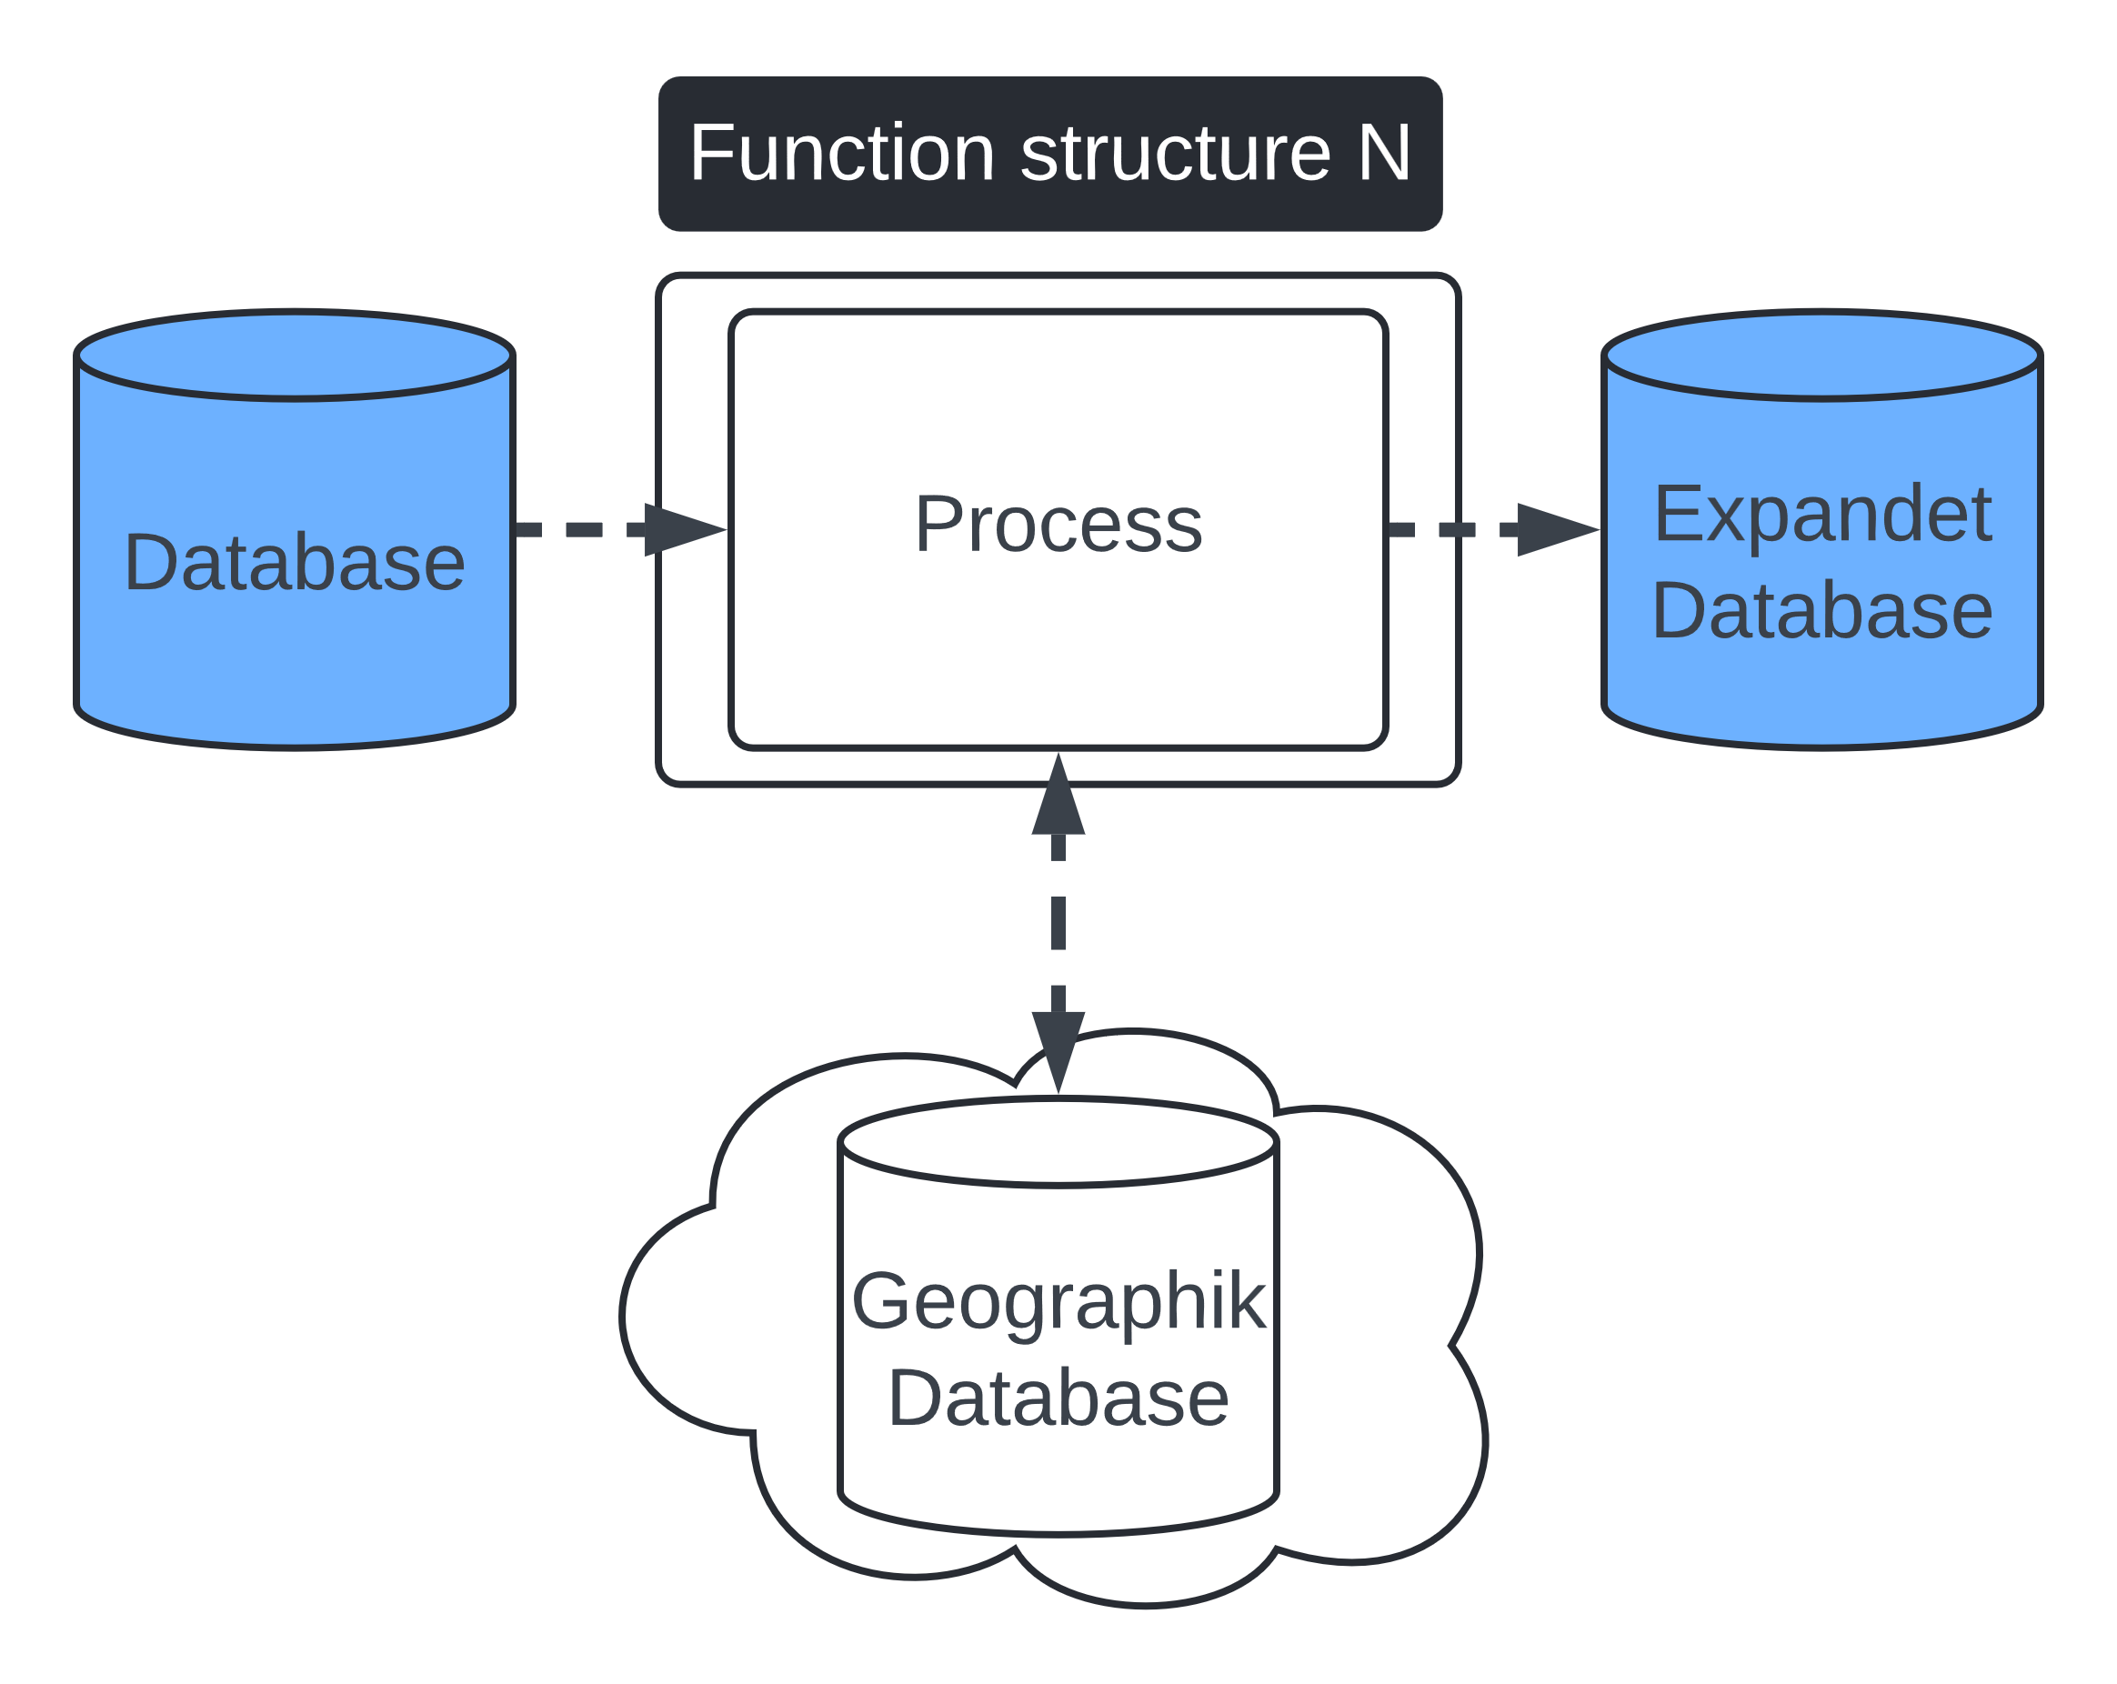
Idee
Structure
Background
Port form database
API pull
Map processing
Danger Scoring
Future improvement

Slide 5
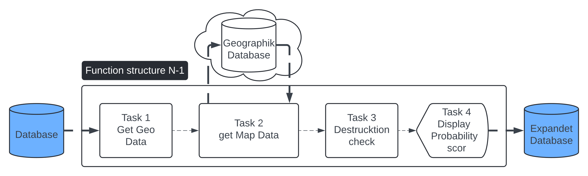
Idee
Structure
Background
Port form database
API pull
Map processing
Danger Scoring
Future improvement

Slide 6
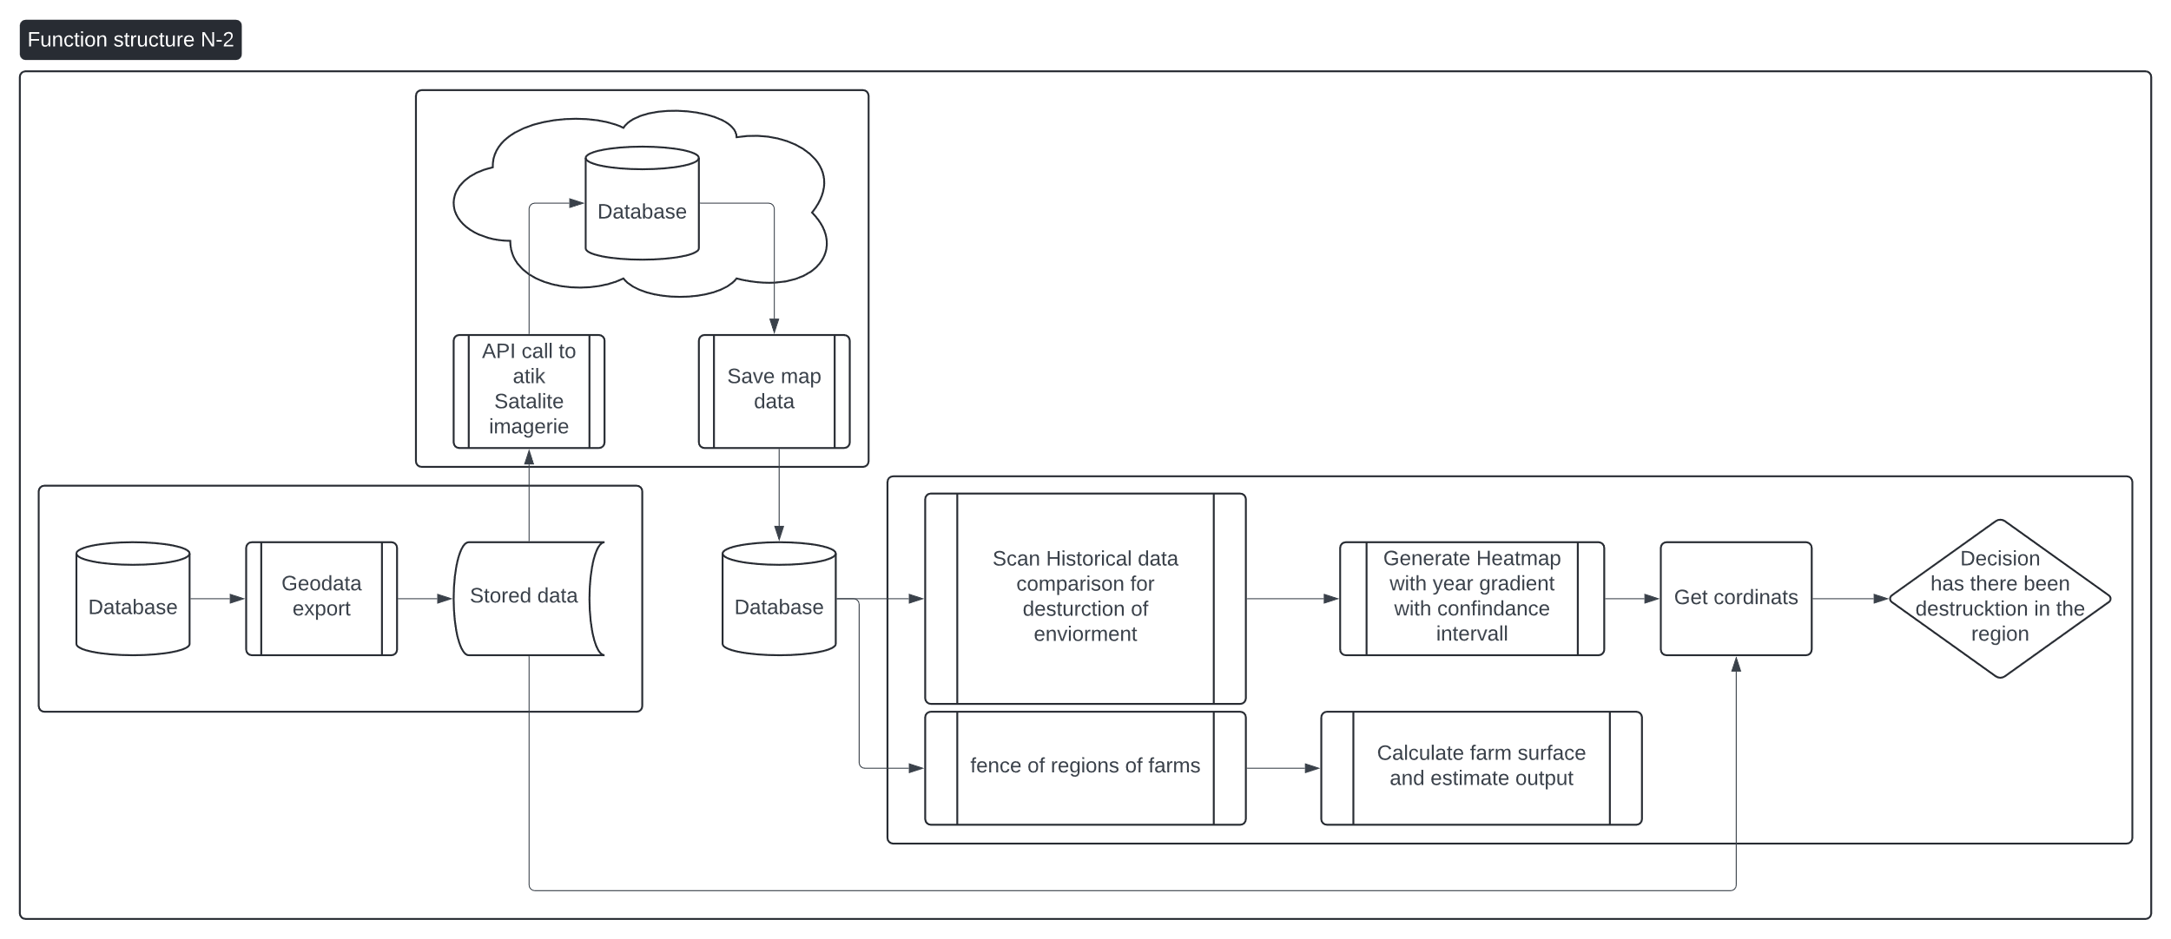
Idee
Structure
Background
Port form database
API pull
Map processing
Danger Scoring
Future improvement

Slide 7
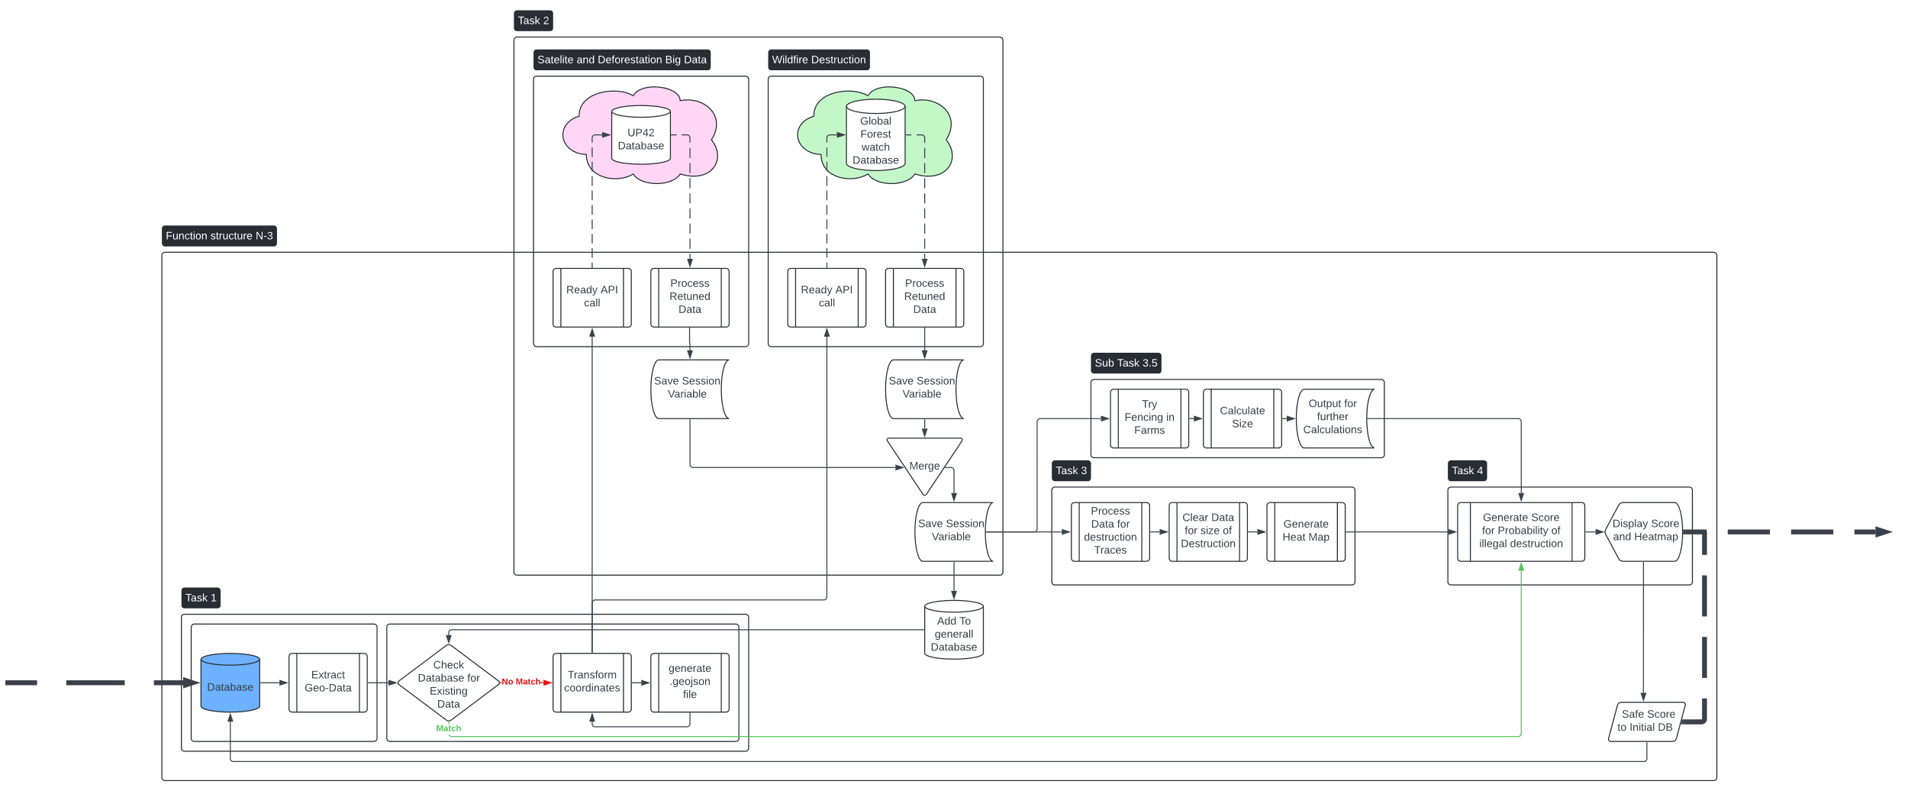
Idee
Structure
Background
Port form database
API pull
Map processing
Danger Scoring
Future improvement

Slide 8
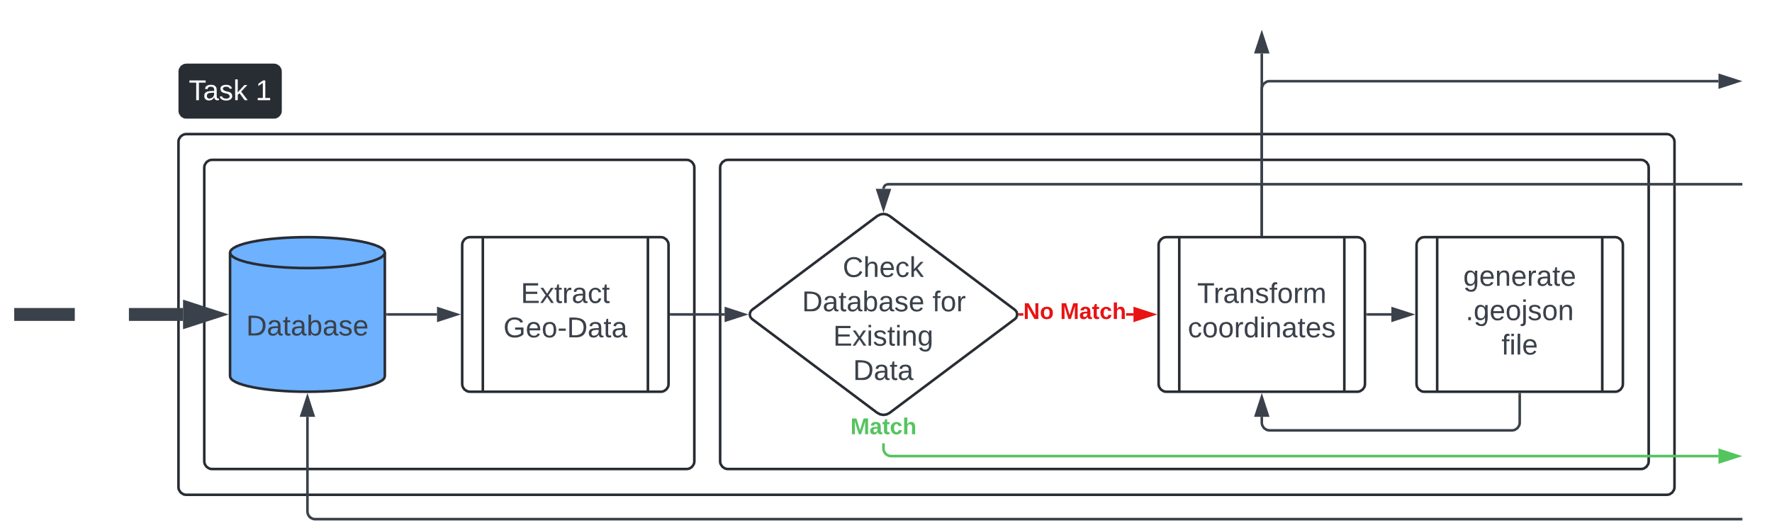
Idee
Structure
Background
Port form database
API pull
Map processing
Danger Scoring
Future improvement

Slide 9
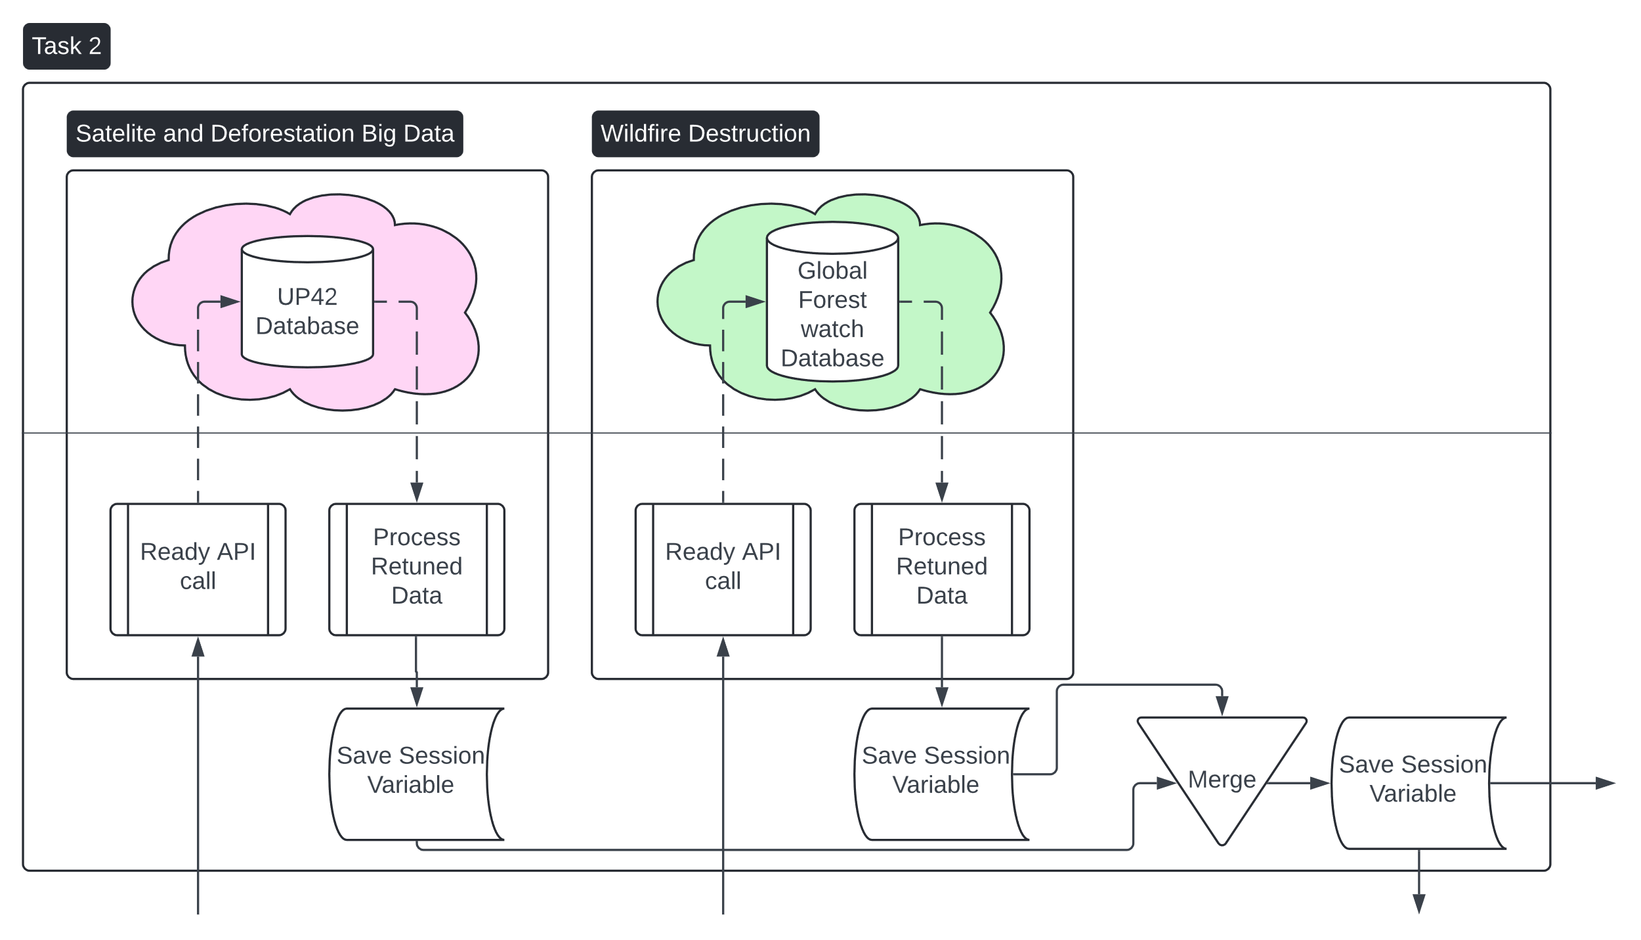
Idee
Structure
Background
Port form database
API pull
Map processing
Danger Scoring
Future improvement

Slide 10
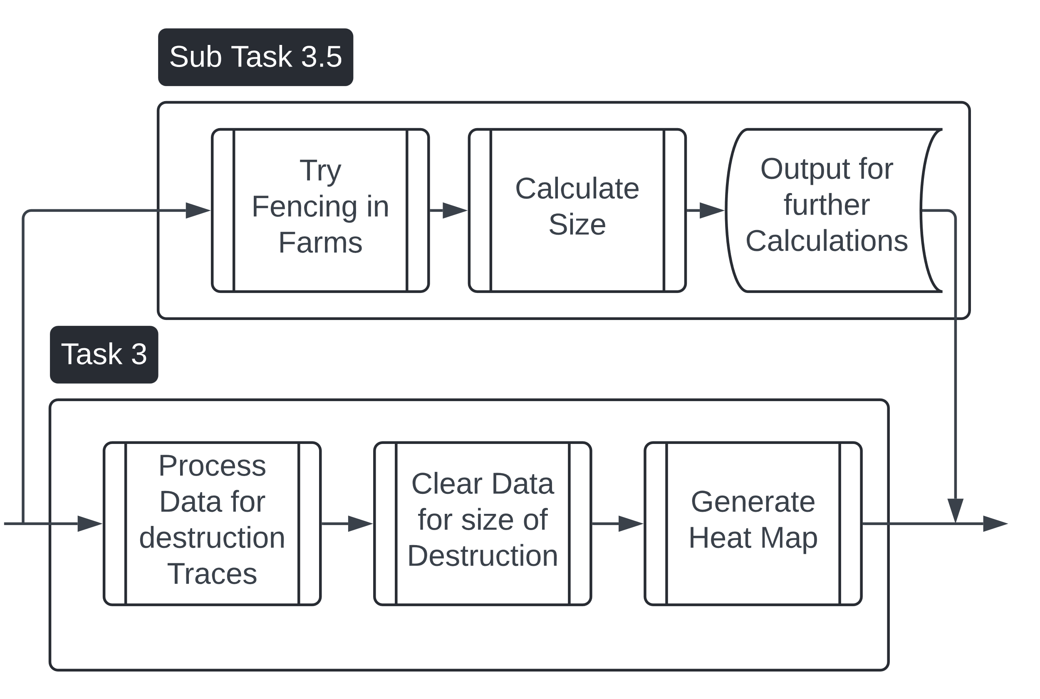
Idee
Structure
Background
Port form database
API pull
Map processing
Danger Scoring
Future improvement

Slide 11
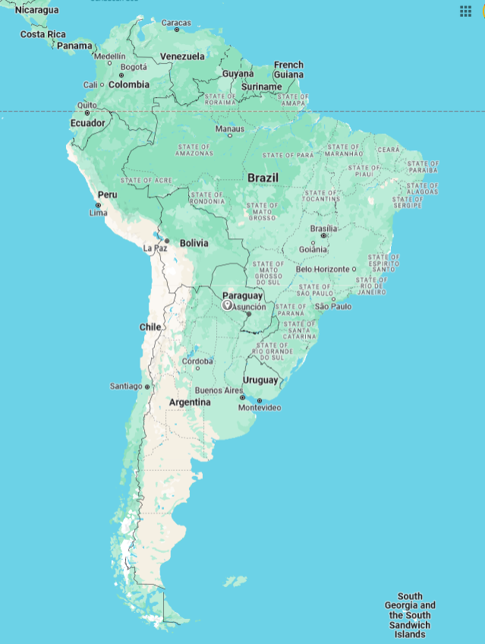
Idee
Structure
Background
Port form database
API pull
Map processing
Danger Scoring
Future improvement

Slide 12
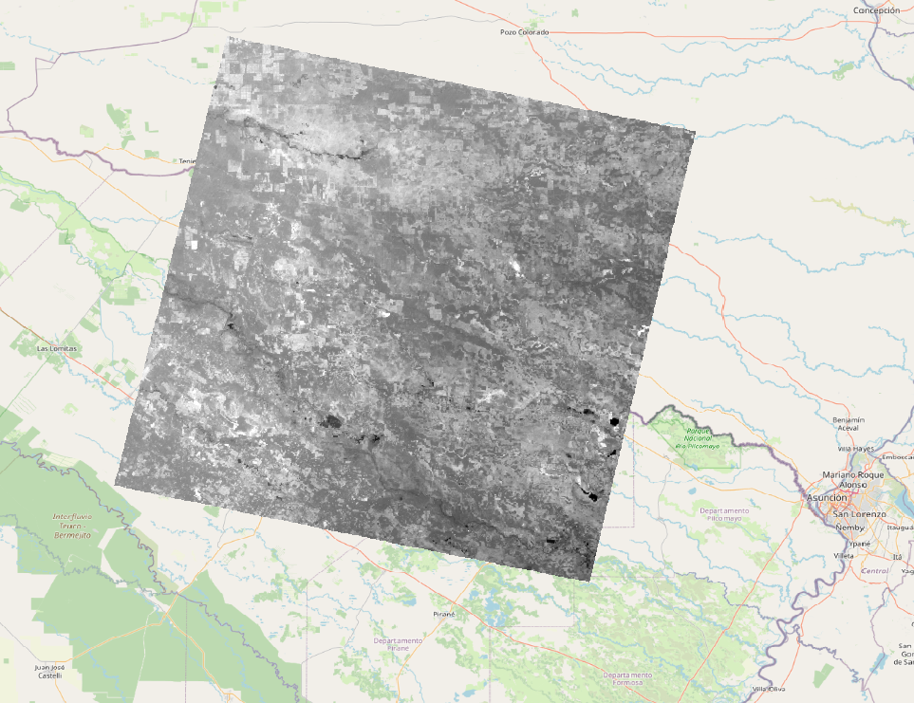
Idee
Structure
Background
Port form database
API pull
Map processing
Danger Scoring
Future improvement

Slide 13
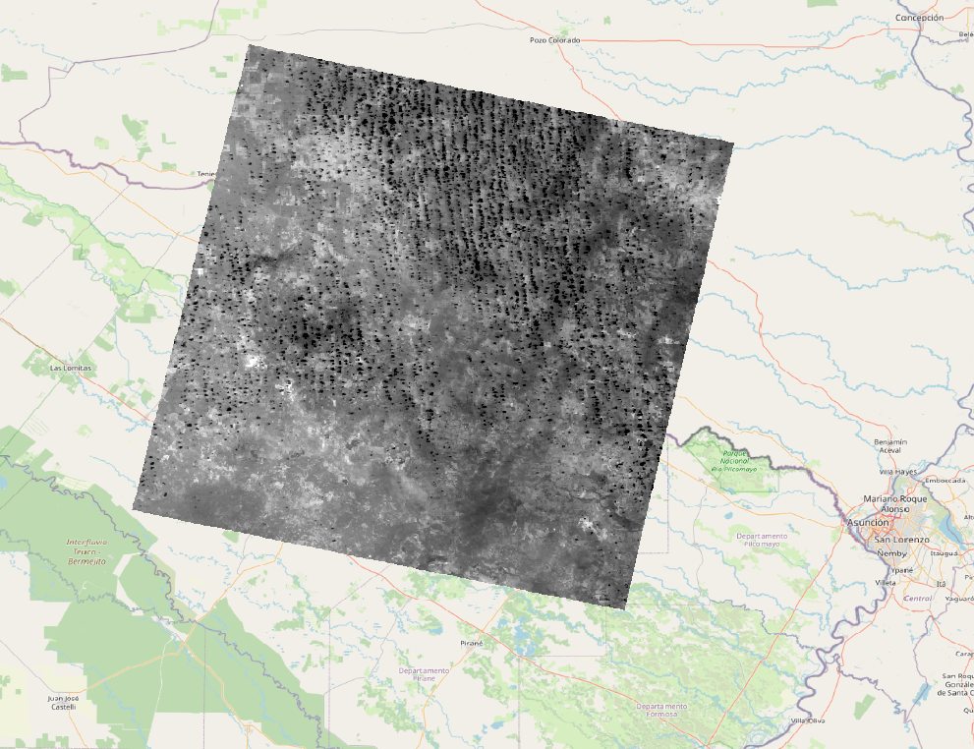
Idee
Structure
Background
Port form database
API pull
Map processing
Danger Scoring
Future improvement

Slide 14
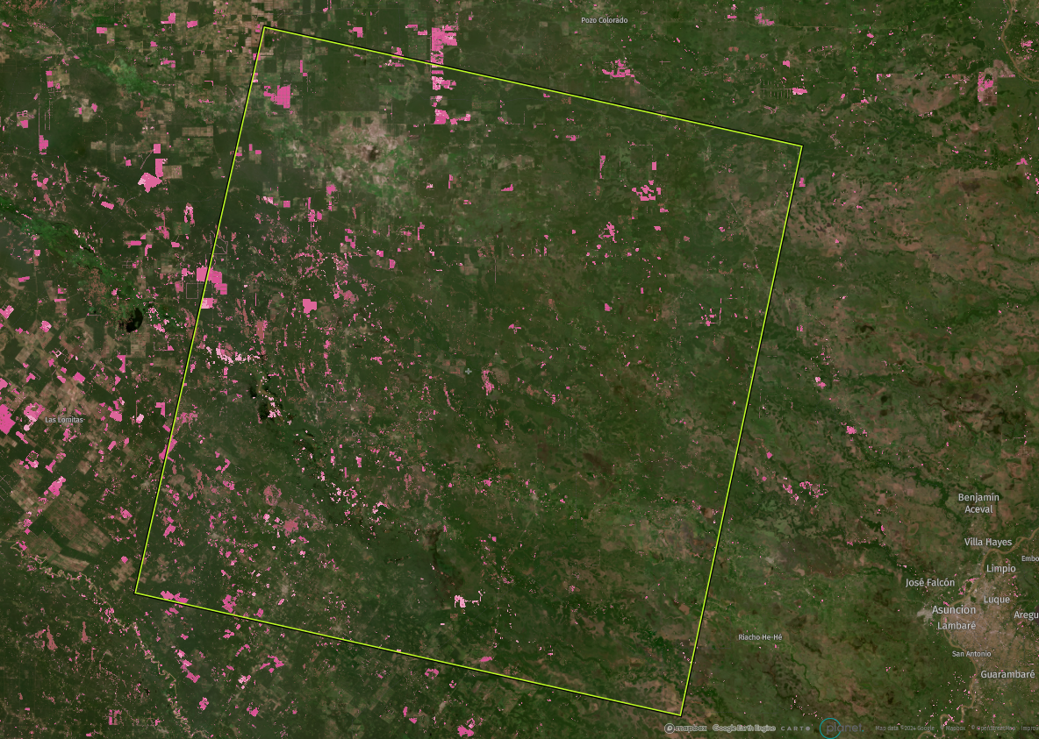
Idee
Structure
Background
Port form database
API pull
Map processing
Danger Scoring
Future improvement

Slide 15
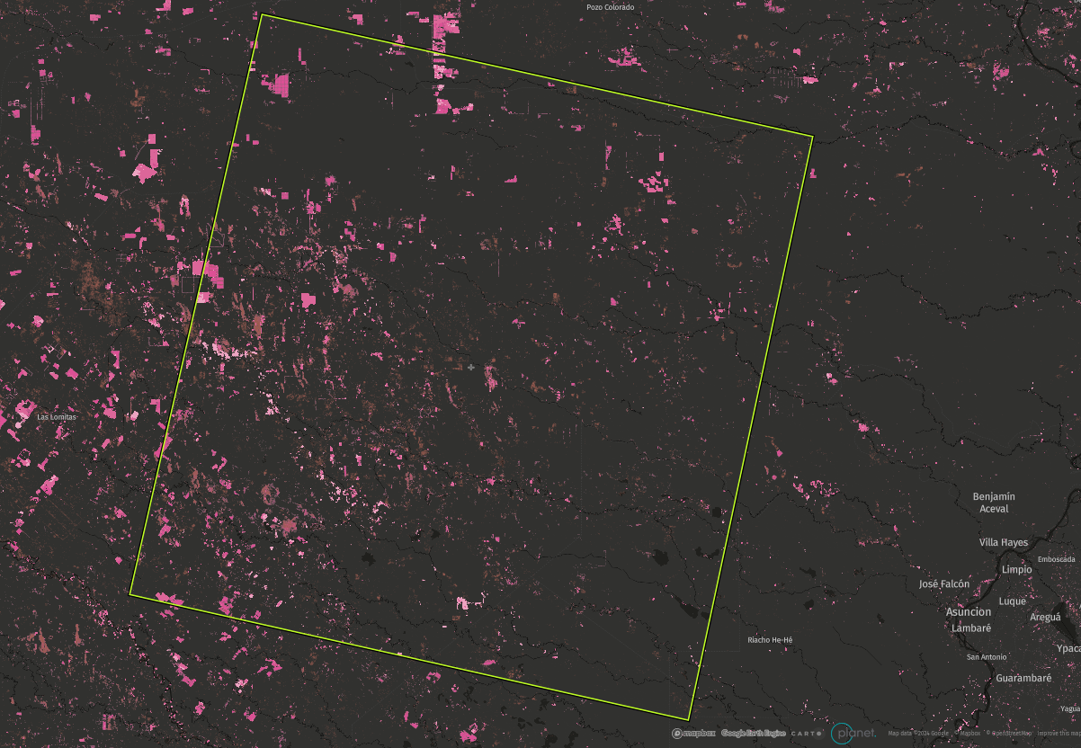
Idee
Structure
Background
Port form database
API pull
Map processing
Danger Scoring
Future improvement

Slide 16
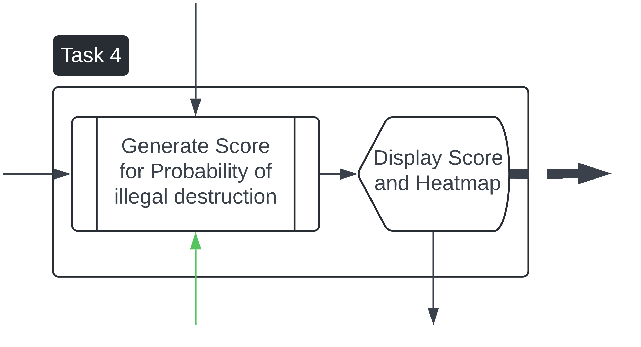
Idee
Structure
Background
Port form database
API pull
Map processing
Danger Scoring
Future improvement

Slide 17
Idee
Structure
Background
Port form database
API pull
Map processing
Danger Scoring
Future improvement
A study using Monte Carlo Simulation for failure probability calculation in Reliability-Based Optimization
Padmanabhan, D., Agarwal, H., Renaud, J.E. et al. A study using Monte Carlo Simulation for failure probability calculation in Reliability-Based Optimization. Optim Eng 7, 297–316 (2006). https://doi.org/10.1007/s11081-006-9973-8

Slide 18
Idee
Structure
Background
Port form database
API pull
Map processing
Danger Scoring
Future improvement
Improvements
Automate Parts of the Process
Buy better Satellite Data
Look at other API’s
Limitations
Only fires that are noticeable
Ignores other kinds of forest destruction

Slide 19
Detecting illegal deforestation via satellite imagery
PENDURA
and connecting remote environments to accountability databases.
Many thanks to Pendura for the project idea and support during the whole process

Slide 20
Thanks For Listening
Detecting illegal deforestation via satellite imagery
and connecting remote environments to accountability databases.
Good luck with your Presentations

